Slide 1


Slide 2

Agenda
Welcome 10 minutes
(Speaker/Video) (10-15 mins)
Step 1: Intros and Background 10 minutes
Step 2: Application Cards 15 minutes
Step 3: Choose an Application 5 minutes
Step 4: Discuss and Recommend 35 minutes
Step 5: Report Out 10 minutes

Slide 3
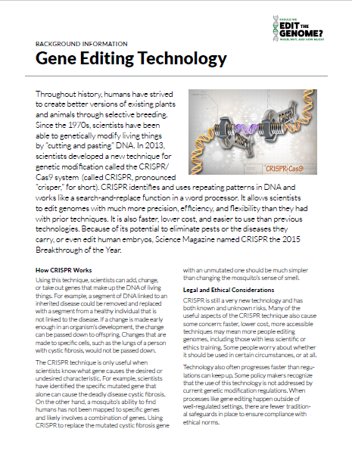
Step 1: Intros and Background
1 page, 10 minutes
10
minutes remaining
65 minutes until report out

Slide 4
Step 1: Intros and Background
1 page, 10 minutes
5
minutes remaining
60 minutes until report out

Slide 5
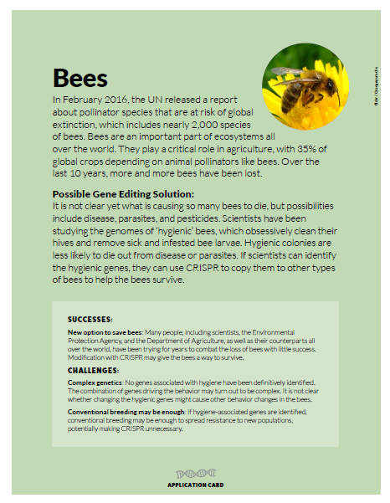
Step 2: Application Cards
6 cards, 15 minutes
15
minutes remaining
55 minutes until report out

Slide 6
Step 2: Application Cards
6 cards, 15 minutes
10
minutes remaining
50 minutes until report out

Slide 7
Step 2: Application Cards
6 cards, 15 minutes
5
minutes remaining
45 minutes until report out

Slide 8
Step 3: Choose an Application
5 minutes
5
minutes remaining
40 minutes until report out

Slide 9
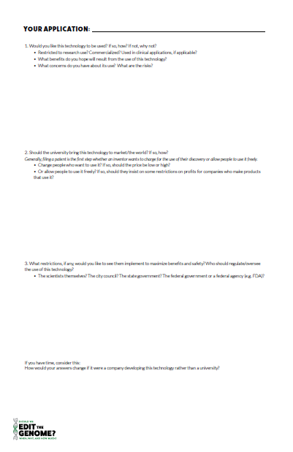
Step 4: Discuss and Recommend
35 minutes
35
minutes remaining
35 minutes until report out

Slide 10
Step 4: Discuss and Recommend
35 minutes
30
minutes remaining
30 minutes until report out

Slide 11
Step 4: Discuss and Recommend
35 minutes
25
minutes remaining
25 minutes until report out

Slide 12
Step 4: Discuss and Recommend
35 minutes
20
minutes remaining
20 minutes until report out

Slide 13
Step 4: Discuss and Recommend
35 minutes
15
minutes remaining
15 minutes until report out

Slide 14
Step 4: Discuss and Recommend
35 minutes
10
minutes remaining
10 minutes until report out

Slide 15
Step 4: Discuss and Recommend
35 minutes
5
minutes remaining
5 minutes until report out

Slide 16
Step 4: Discuss and Recommend
35 minutes
1
minute remaining
1 minute until report out

Slide 17

Time is up!

Slide 18
Step 5: Report Out
10 minutes

